Slide 1
STRATEGIC VALUE OF information technology
Lecture 1
Introduction

Slide 2
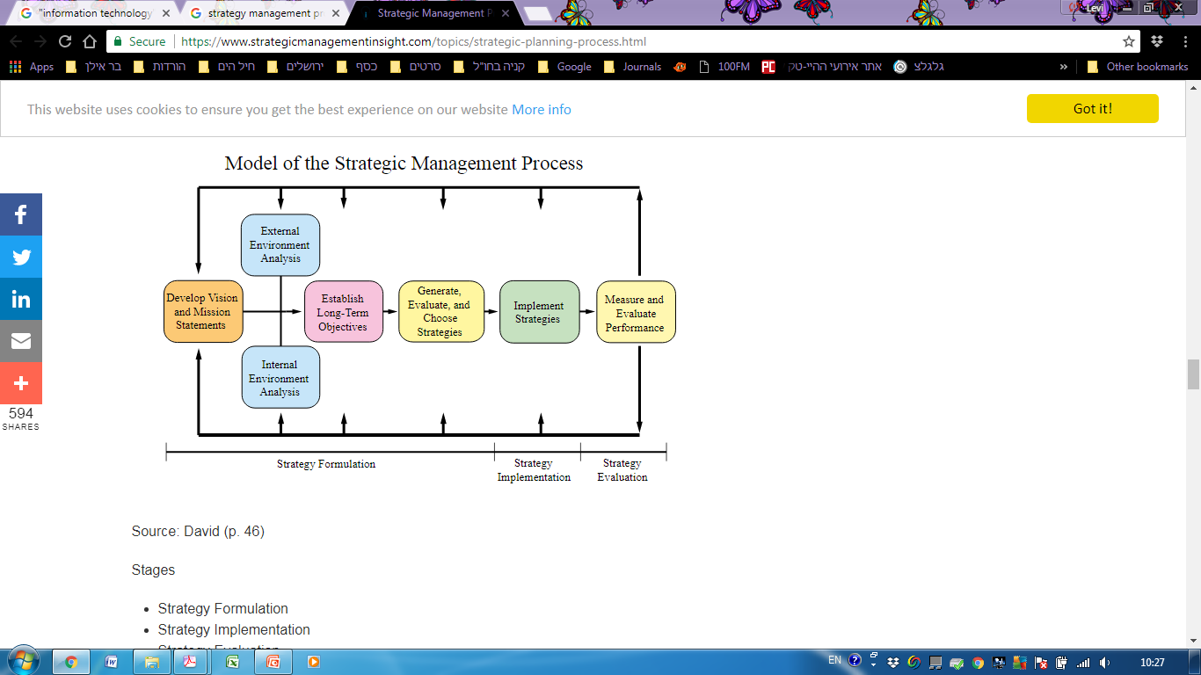

Course scope

Slide 3
Lesson Goals
KNOWLEDGE AGE
KNOWLEDGE AGE
IT – A COMMODITY OR A STRATEGIC ASSET ?
IT COMPONENTS AND CLASSIFICATION

Slide 4
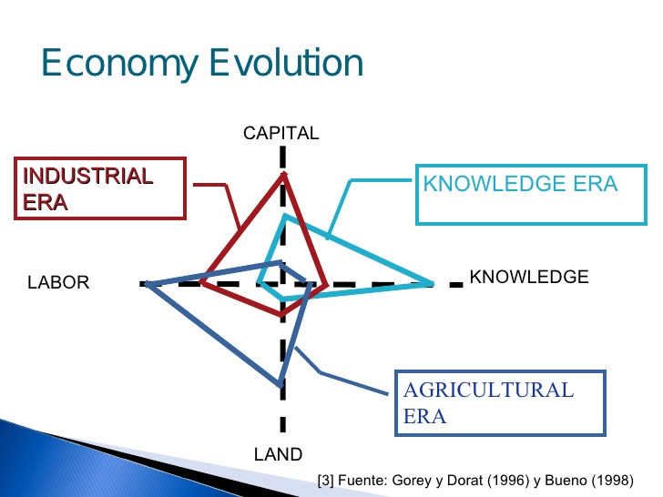
KNOWLEDGE AGE
KNOWLEDGE AGE

Slide 5
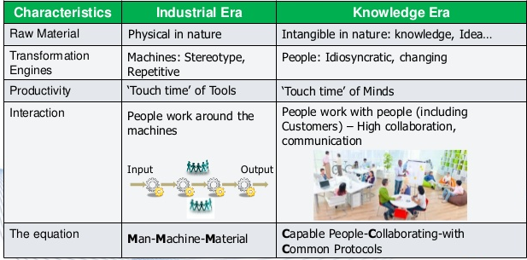
DIFFERENCES
KNOWLEDGE AGE

Slide 6

How is the world changing?
KNOWLEDGE AGE
Globalization
Automation
Demographic change
Workplace change
Personal risk and responsibility

Slide 7

Automation
KNOWLEDGE AGE

Slide 8
Automation - Job tasks are changing across the economy
KNOWLEDGE AGE

Slide 9




Globalization
KNOWLEDGE AGE
1.0
2.0
3.0
Devices
Global Manufacturing
Competing with everyone from everywhere for everything
Global Trade

Slide 10
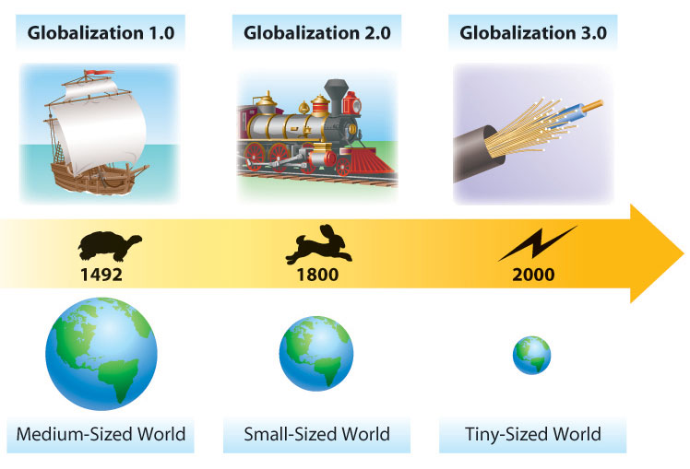
Globalization
KNOWLEDGE AGE
Globalization created a new world characterized by:
Collaboration without barriers
Fast communication
Worldwide communication

Slide 11
Evolution of Globalization
KNOWLEDGE AGE
Globalization 1.0
Mainly European countries are globalizing
Power is the primary driver
Industries changed
Slow pace of change

Slide 12
Evolution of Globalization
KNOWLEDGE AGE
Globalization 2.0
Companies are globalizing
Reduction in transportation and telecom-munications costs
Mainly Europe and America involved

Slide 13
Evolution of Globalization
KNOWLEDGE AGE
Globalization 3.0
Individuals and small groups are globalizing
Faster pace of change
Emergence of new industries

Slide 14
Evolution of Globalization: Summary
KNOWLEDGE AGE
The World Is Flat (Thomas L. Friedman)
“10 Enablers”
Key factors enabling Globalization 3.0

Slide 15
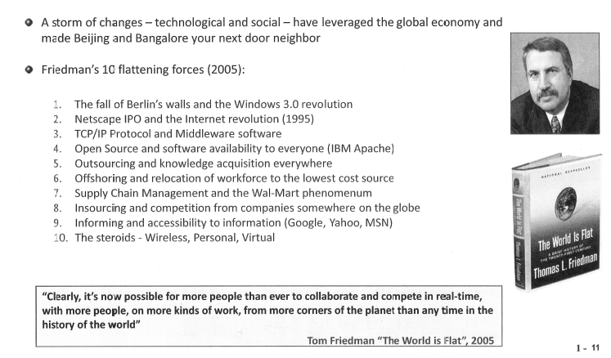
The world is flat
KNOWLEDGE AGE

Slide 16

Globalization
KNOWLEDGE AGE
In top 1,000 companies:
Use of self-managing work teams rose from 28% in 1988 to 65% in 2005.
Work teams are increasingly global.

Slide 17
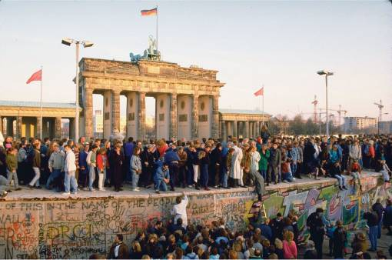
Enabler #1: The Fall of the Berlin Wall
KNOWLEDGE AGE
November 9, 1989
Fall of communism
People from the former communist countries gained more freedom

Slide 18
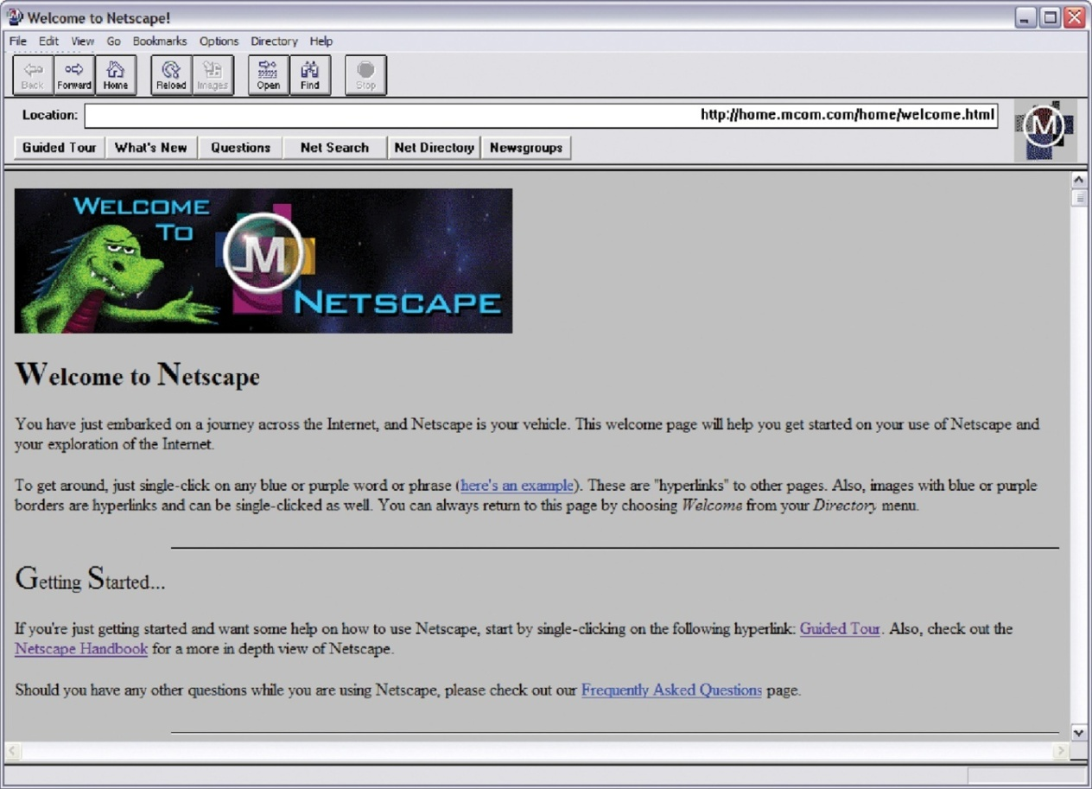
Enabler #2: Netscape Browser
KNOWLEDGE AGE
August 9, 1995
“Killer app”
First mainstream browser
Gave individuals access to the Internet & set standards

Slide 19
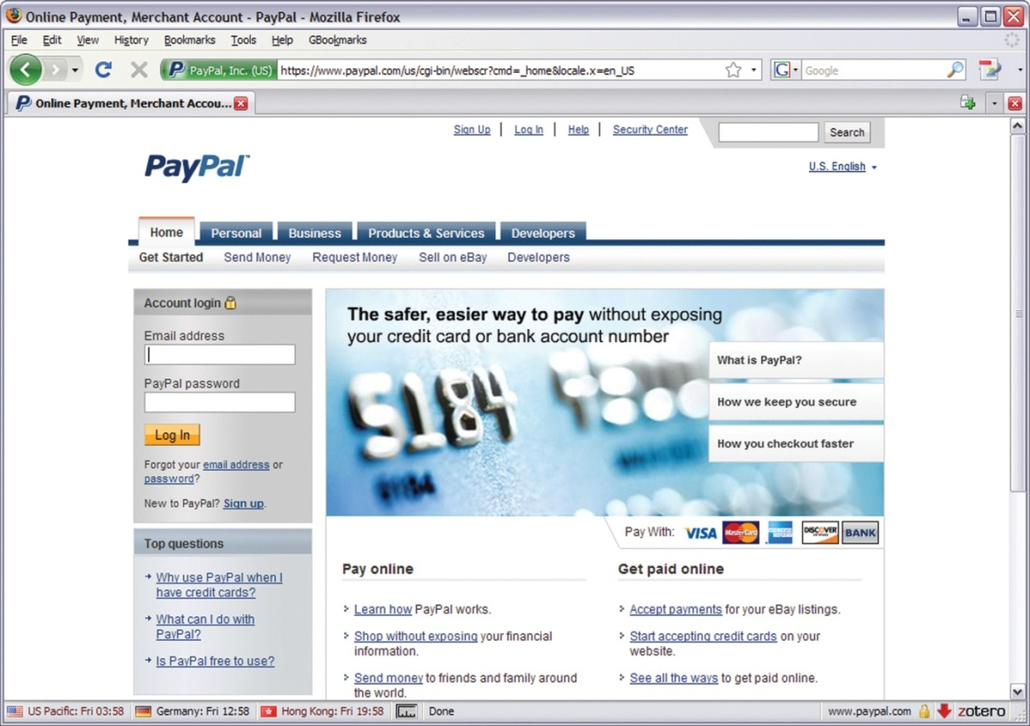
Enabler #3: Work Flow Software
KNOWLEDGE AGE
Applications that allow people worldwide to communicate
XML: applications “talk” to each other
New possibilities for information sharing
Secured payments to fuel commerce

Slide 20
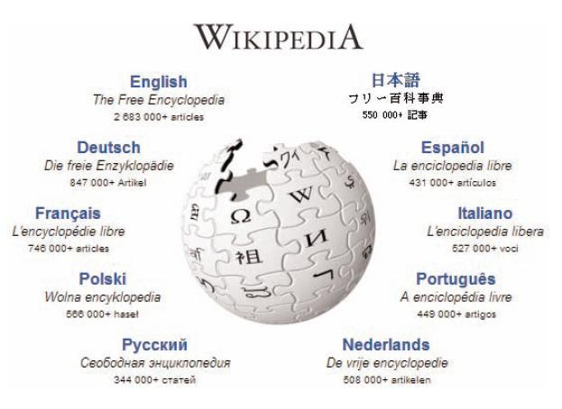
Enabler #4: Uploading
KNOWLEDGE AGE
Individuals and companies actively participate in content generation on the Web

Slide 21
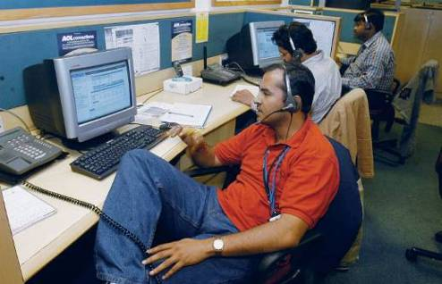
Enabler #5: Outsourcing
KNOWLEDGE AGE
Outsourcing companies profited from the drop in telecommunications costs
Companies can now use talented engineers from anywhere

Slide 22
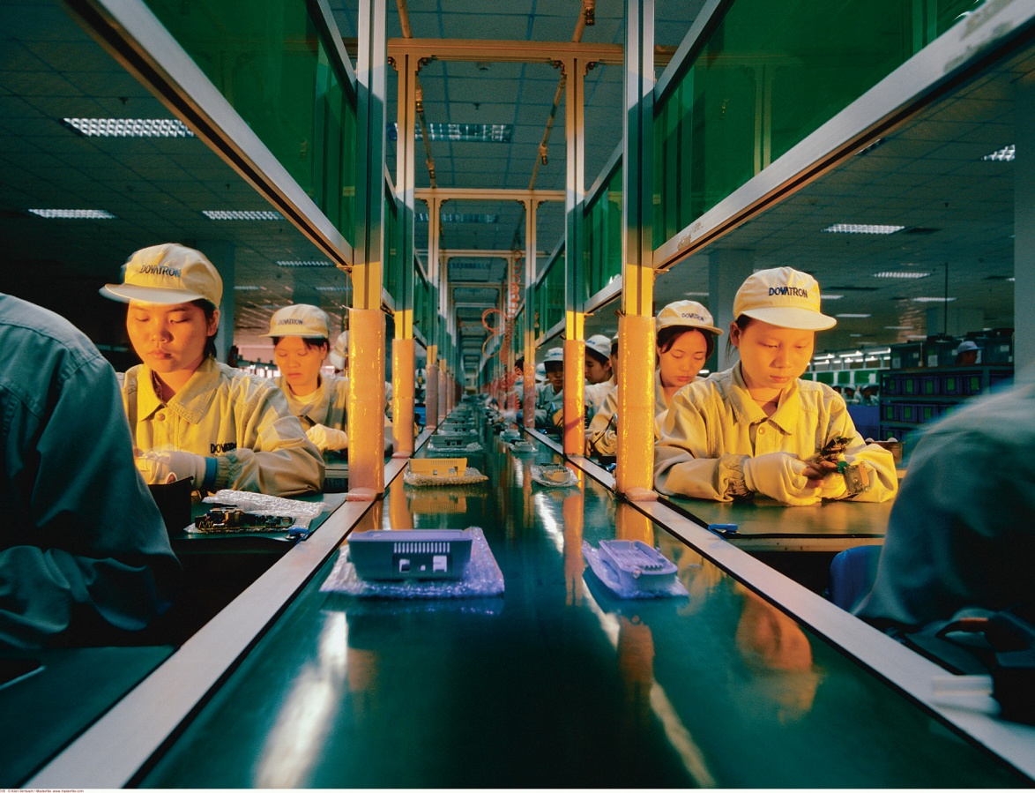
Enabler #6: Offshoring
KNOWLEDGE AGE
Companies set up entire factories in countries such as China
Mass production
Low costs

Slide 23
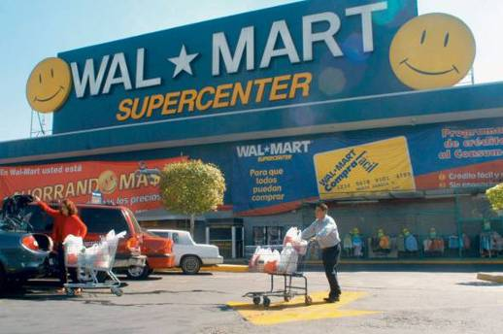
Enabler #7: Supply Chain
KNOWLEDGE AGE
Integration of retailers, suppliers, and customers
Wal-Mart became an early leader
Use of RFID tags

Slide 24
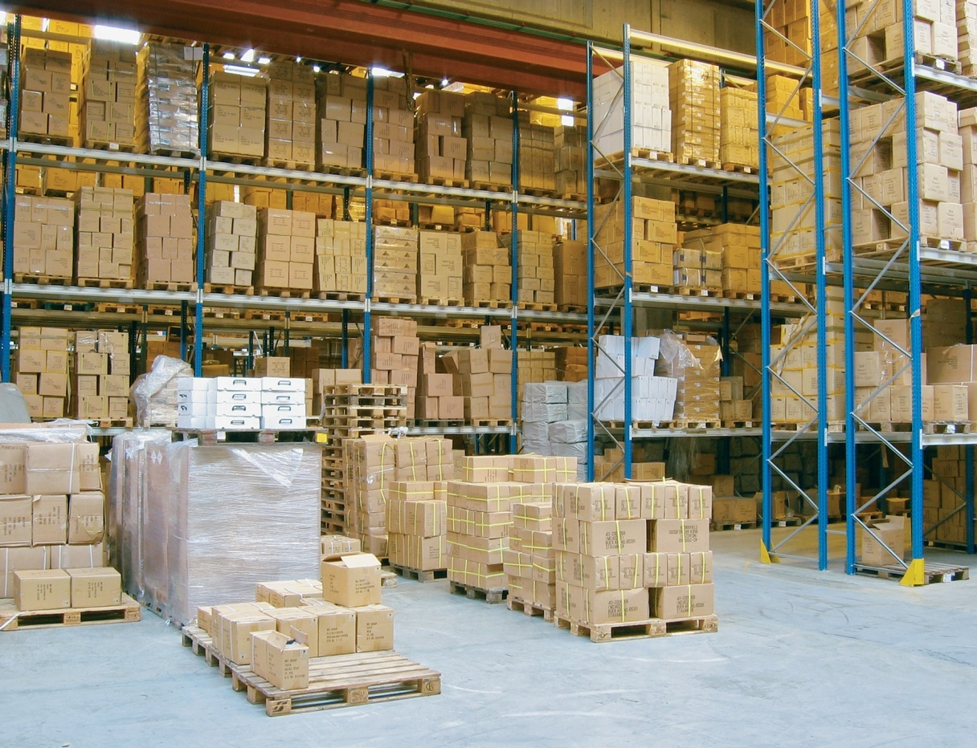
Enabler #8: In-Sourcing
KNOWLEDGE AGE
Delegation of company’s key operations to a subcontractor
Example: UPS provides complete supply chain solutions to companies

Slide 25
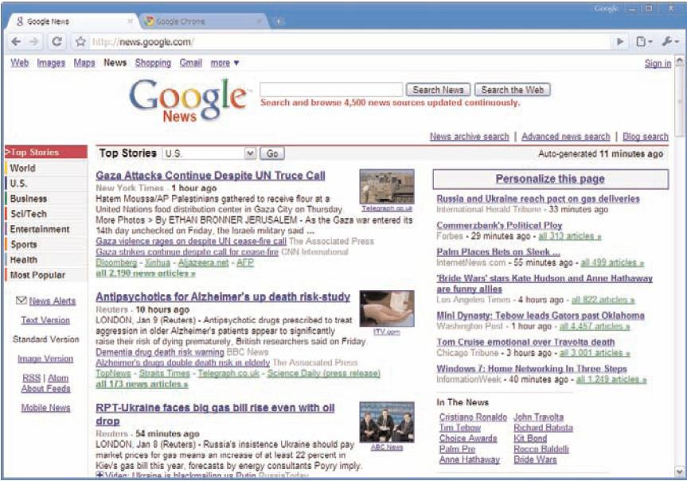
Enabler #9: In-Forming
KNOWLEDGE AGE
Individuals have access to massive amounts of information regarding services of outsourcing, offshoring, and in-sourcing

Slide 26

Enabler #10: The Steroids
KNOWLEDGE AGE
Technologies that support different types of collaboration
Greater mobility
Triple convergence

Slide 27
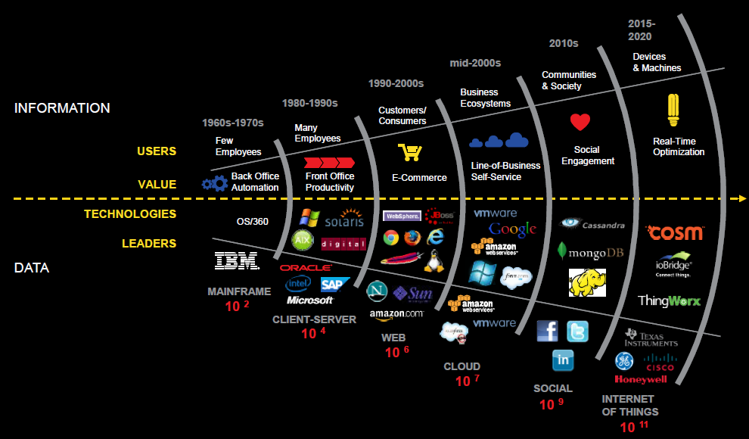
Evolution of Data
KNOWLEDGE AGE

Slide 28

Evolution of Devices
KNOWLEDGE AGE

Slide 29
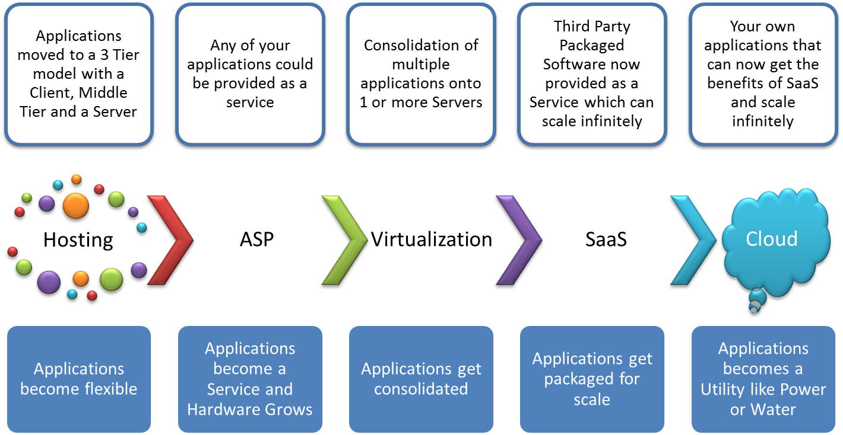
Evolution of Cloud
KNOWLEDGE AGE

Slide 30
Information technology (IT) – A COMMODITY OR A STRATEGIC ASSET?
IT – A STRATEGIC ASSET

Slide 31
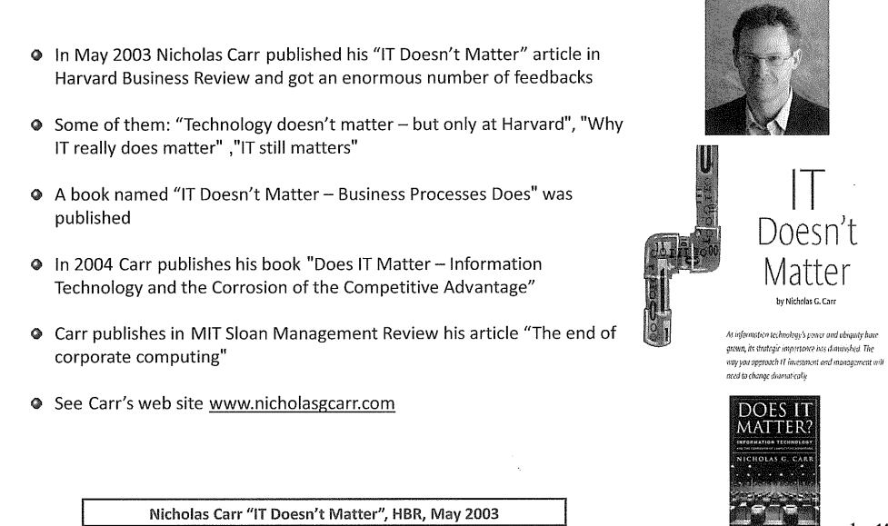
Does It matter ?

Slide 32
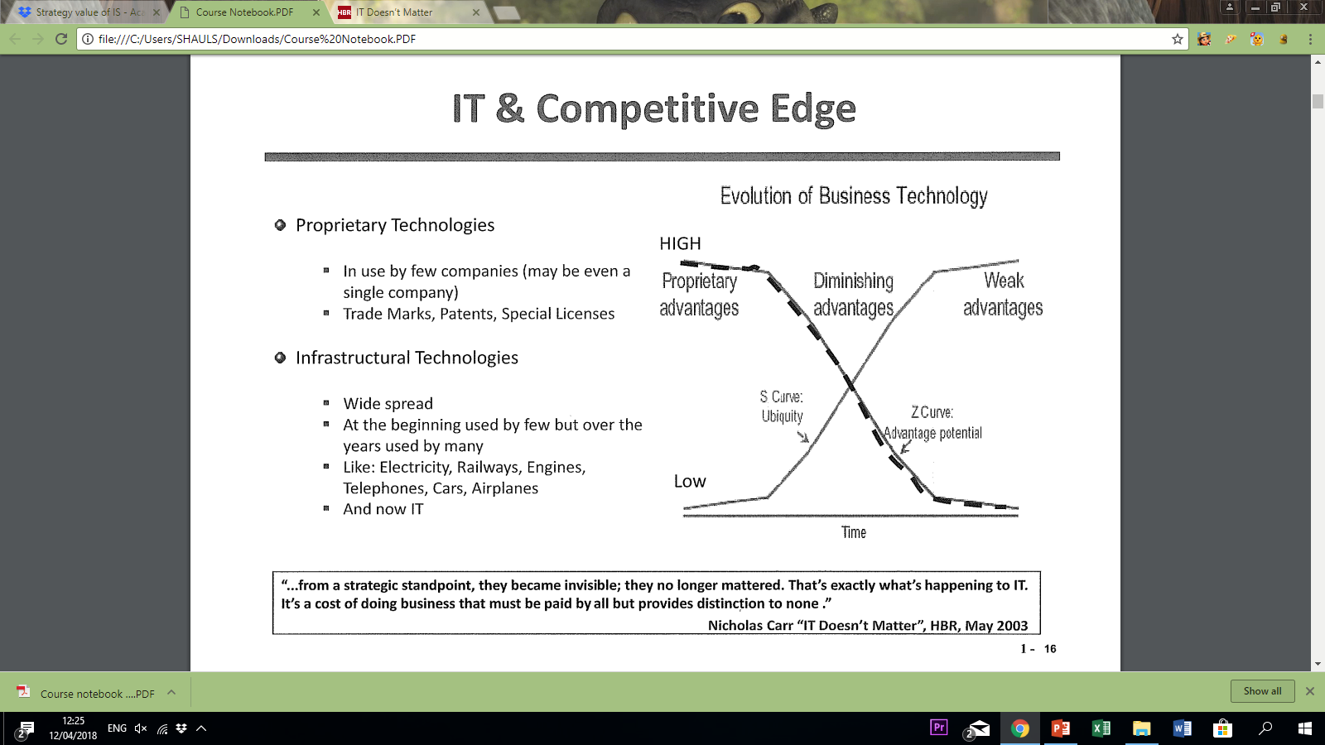
It and competitive edge

Slide 33
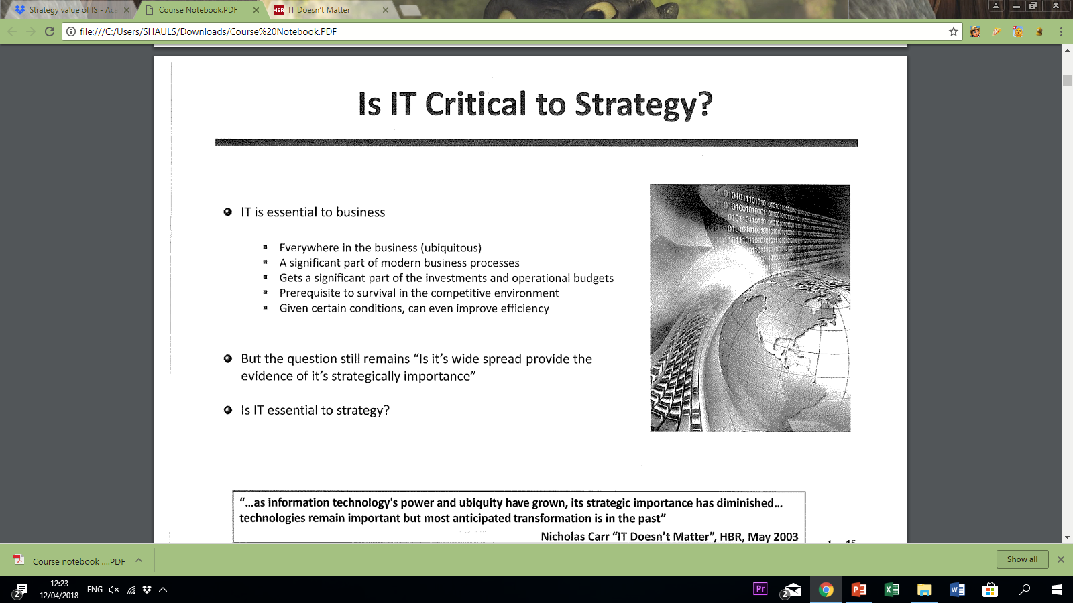
Is It critical to strategy

Slide 34
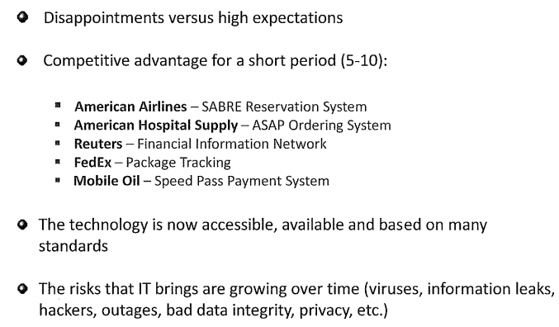
Low advantages Vs. high risks

Slide 35
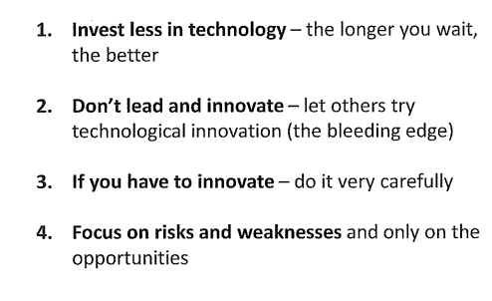
Recommedations by Carr

Slide 36
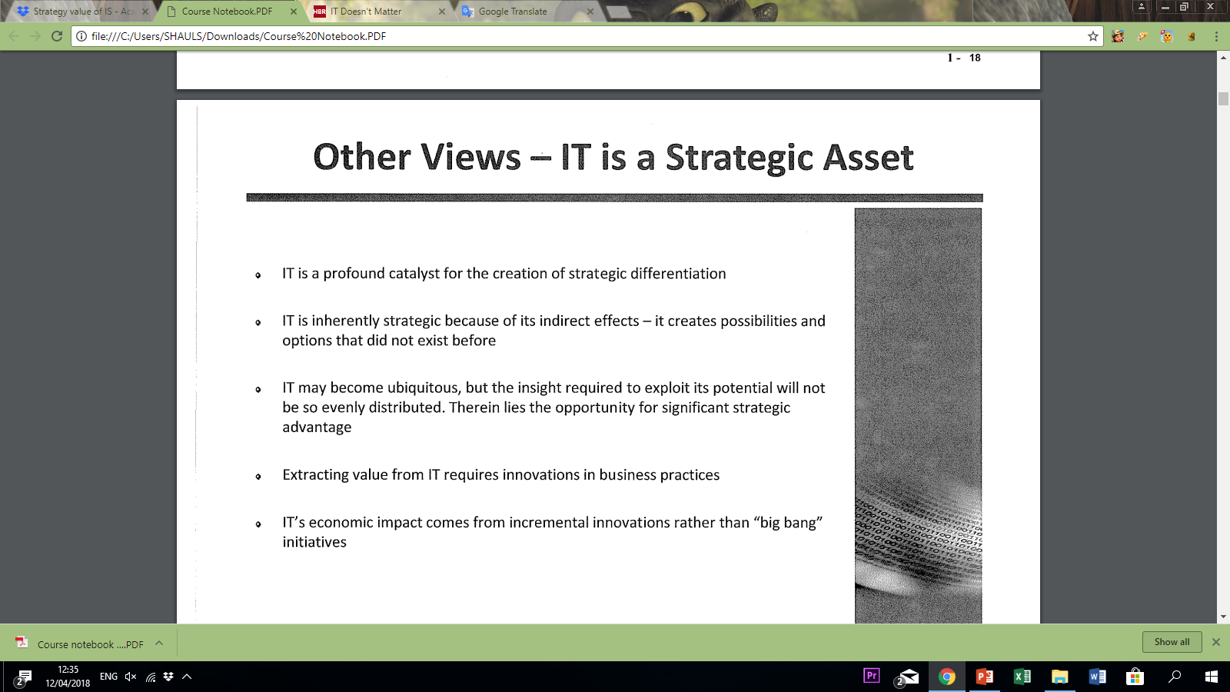
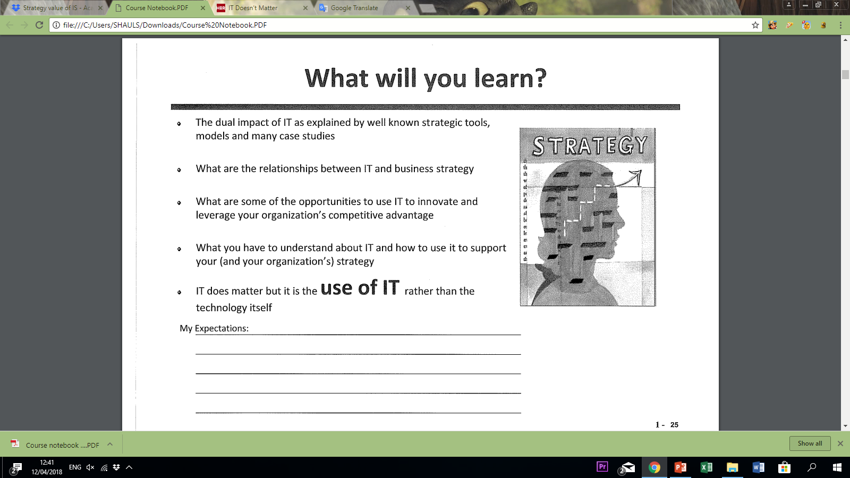
Other views

Slide 37
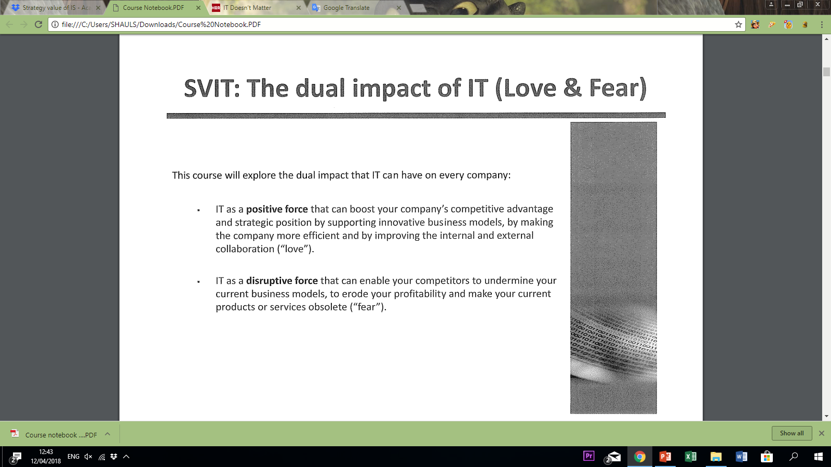
The dual impact of it (Love and Fear)

Slide 38
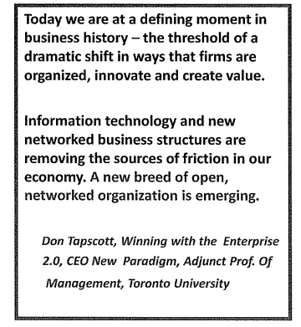
IT expansion

Slide 39

Amazon – Mission
IT – A STRATEGIC ASSET
becoming the best e-commerce company in the world.
Global reach
Customer prioritization
Widest selection of products

Slide 40

Amazon – Mission
IT – A STRATEGIC ASSET
“To be Earth’s most customer-centric company, where customers can find and discover anything they might want to buy online.

Slide 41
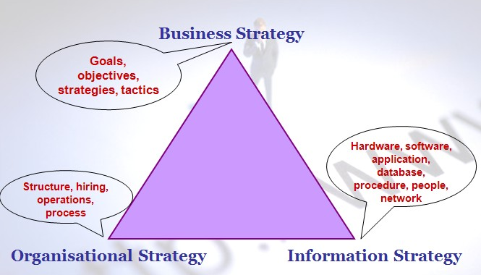
Information technology (IT) – A COMMODITY OR A STRATEGIC ASSET?
IT – A STRATEGIC ASSET
חזון
תהליכים עסקיים ליצירת ערך
תשתית IT תומכת
Notes:
סטרטגיה עסקית היא חזון היטב של המקום שבו העסק מבקש ללכת ואיך הוא מצפה להגיע לשם. זהו הצורה שבה העסק מתקשר למטרותיו.
האסטרטגיה הארגונית עוסקת בחזון העתיד של העסק המשפחתי שלך, יצירת ערך בעיני הלקוחות שלך, בניית ושמירה על עמדה חזקה בשוק.
סטרטגיה עסקית היא חזון היטב של המקום שבו העסק מבקש ללכת ואיך הוא מצפה להגיע לשם. זהו הצורה שבה העסק מתקשר למטרותיו.
האסטרטגיה הארגונית עוסקת בחזון העתיד של העסק המשפחתי שלך, יצירת ערך בעיני הלקוחות שלך, בניית ושמירה על עמדה חזקה בשוק.
סטרטגיה עסקית היא חזון היטב של המקום שבו העסק מבקש ללכת ואיך הוא מצפה להגיע לשם. זהו הצורה שבה העסק מתקשר למטרותיו.
האסטרטגיה הארגונית עוסקת בחזון העתיד של העסק המשפחתי שלך, יצירת ערך בעיני הלקוחות שלך, בניית ושמירה על עמדה חזקה בשוק.
http://cb304-jan0
9.blogspot.co.il/2009/02/importance-of-is-strategy-triangle-and.html

Slide 42
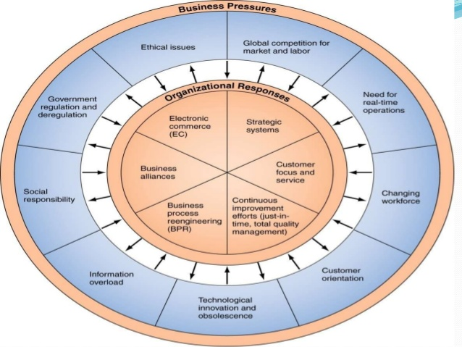
Business pressures
IT – A STRATEGIC ASSET
IT Force

Slide 43
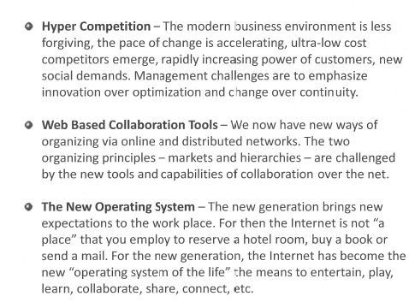
The business landscape changes
IT – A STRATEGIC ASSET

Slide 44
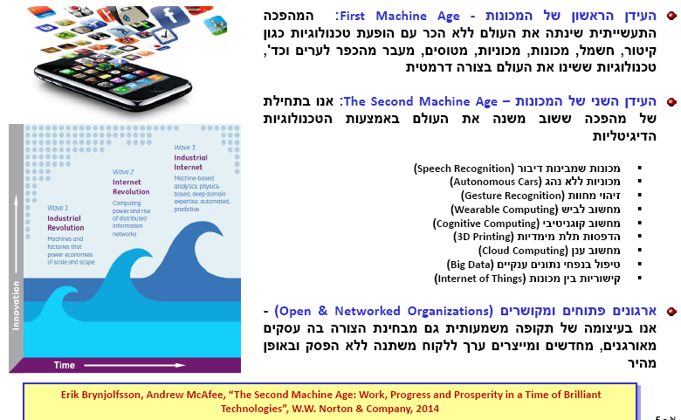
Digital Age
IT – A STRATEGIC ASSET

Slide 45
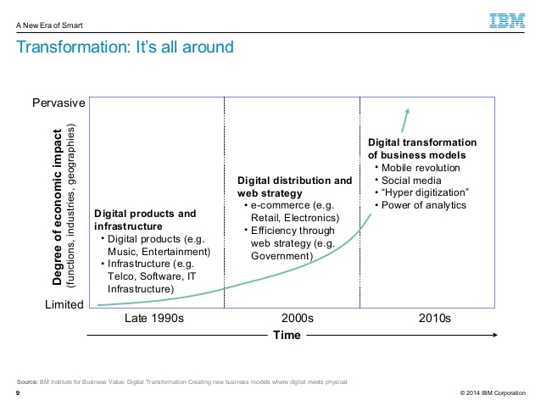
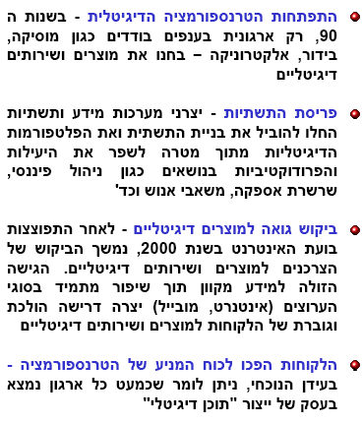
Digital transformation
IT – A STRATEGIC ASSET

Slide 46
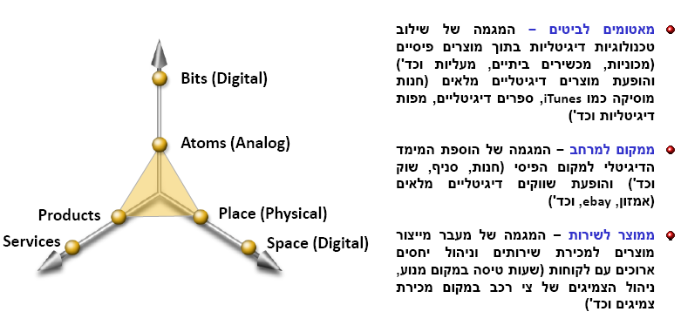
The 3 dimensions of digital transformation
IT – A STRATEGIC ASSET

Slide 47
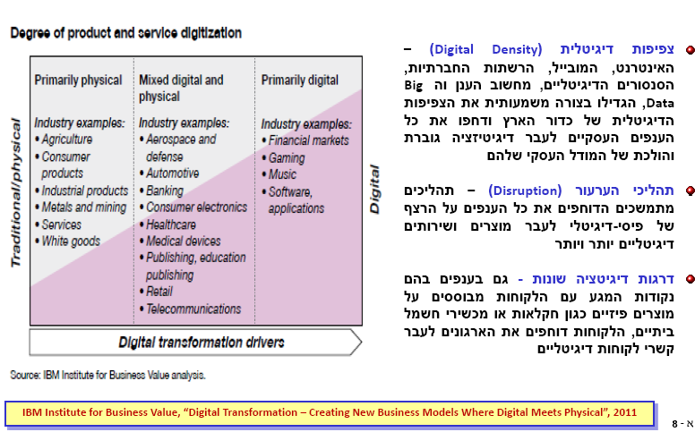
1st dimension – from atoms to Bits
IT – A STRATEGIC ASSET

Slide 48
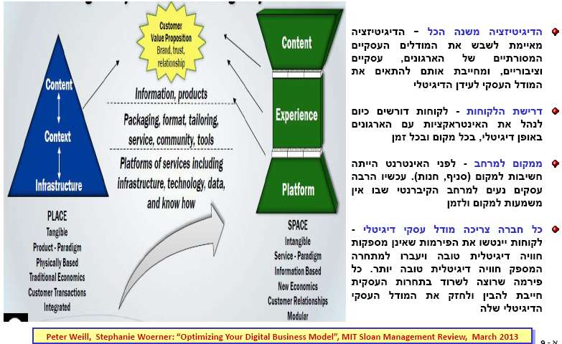
2nd dimension – from place to space
IT – A STRATEGIC ASSET

Slide 49
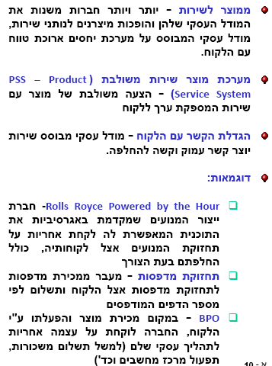
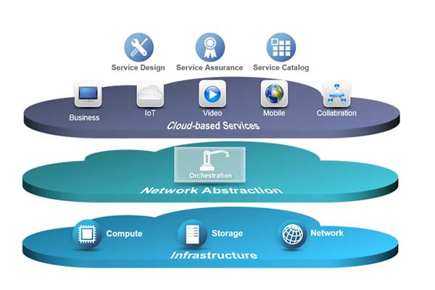
3rd dimension – from product to service
IT – A STRATEGIC ASSET

Slide 50
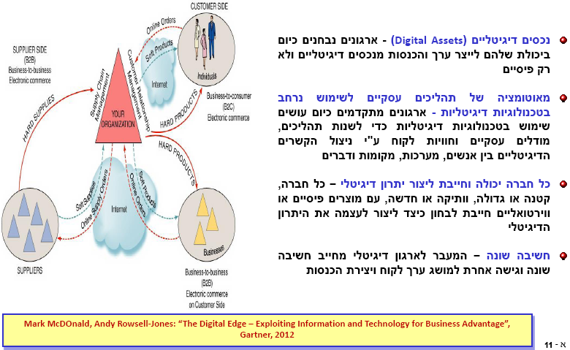
The digital value
IT – A STRATEGIC ASSET

Slide 51
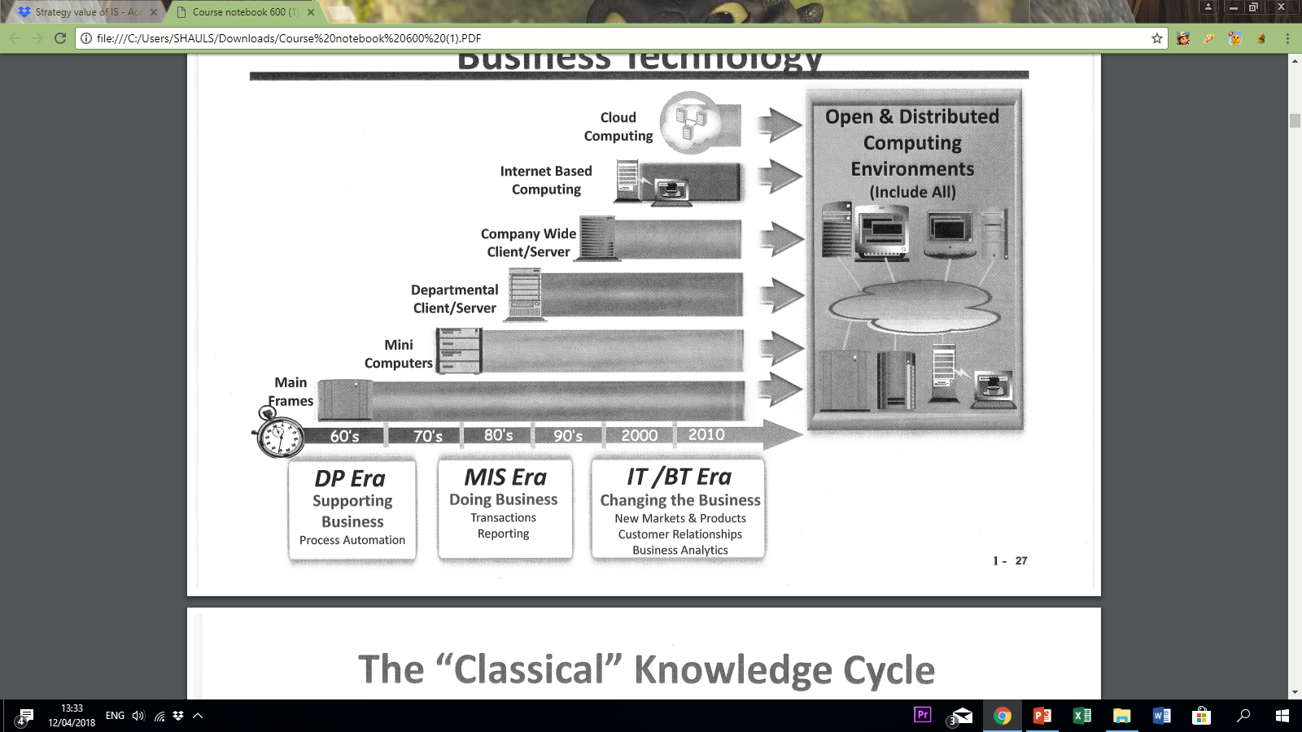
Business technology

Slide 52
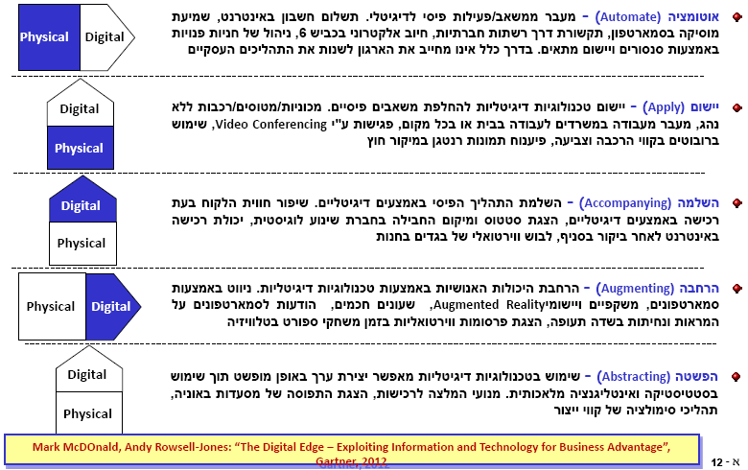
Five models for digital edge creation
IT – A STRATEGIC ASSET

Slide 53
Managing IT as a Business Managing Organizations in the 21st Century
IT – A STRATEGIC ASSET
Organizations must become more agile, transparent, and innovative.
There is great pressure to increase efficiencies and productivity.
Organizational visibility and governance is more important than ever.
Visibility into the Organization
Control – Metrics & Process to Manage
Optimization – Continuous Improvement
Transformational Change
Leverage the Power of IT to Enable the Change
The dramatic economic and global pressures have placed extreme pressure on organizations to accelerate these changes.

Slide 54
Managing IT as a Business Why is it so difficult?
IT – A STRATEGIC ASSET
Most IT plans do not indicate the business value and what strategic or tactical organizational benefit that the organization is trying to achieve.
Prove - The CIO must have the ability to relate IT investments into business value.
Spread - The CIO must report the IT value and guide other executives on achieving and reporting the contribution of the investment on the other executives goals.

Slide 55
Managing IT as a Business The Importance of IT / Business Alignment
IT – A STRATEGIC ASSET
Business and IT shouldn’t just be aligned, they should be “forged together.”
It is important that Business and IT work together in a team based collaborative process and develop a common set of metrics to measure performance.
strategy: Make sure IT is integrated with business planning — and make sure barriers between business and IT are minimized.

Slide 56
Managing IT as a Business Key Questions that Strategic Plans Should Address - Gartner
IT – A STRATEGIC ASSET
Does the IT Strategy Substantiate Mutually Owned Expectations Developed by All Stakeholders?
Are Critical Drivers Influencing the Direction of the IT Strategy Accounted For?
Is the IT Investment Direction and Alignment With Business/Mission Needs and Priorities Made Explicitly Clear?
Does the IT Plan Contain Performance Measures That Can Gauge Progress and Success
Does the Plan Outline the Governance Process to Execute the Strategic Planning Process and Approved IT Investment Decision?

Slide 57
Managing IT as a Business The Importance of IT / Business Alignment
IT – A STRATEGIC ASSET
“Do the right thing”
Strategic Vision -
Effectiveness
“Do it right”
Assets of the Company -
Efficiency
IT Consulting
Services
Construction Management
Services
Application Services
Tracer
Desktop Services
“Plan”
“Build”
Corporate Direction
and Strategy
IT Strategy
“Run”
Core
K
K
K = Knowledge Workers
K
K
Migrate the IT investment $
and/or resources to the high pay-off areas to the business.
Business
Enable Change
Increase levels of productivity – Run/Build
Information Technology

Slide 58
IT Asset Maturity Model
IT – A STRATEGIC ASSET
Where is your organisation?
Centre of Excellence
Proactive
Understanding where your organization is currently positioned in the maturity model, will enable the organisation to map out its path to higher levels of maturity and identify areas to invest in people, process and technology
Active
Reactive
Chaos

Slide 59
Process Maturity: Chaos
Characteristics
No knowledge of what assets are owned or where they are located
Lack adequate tools to track and manage assets
No centralized purchasing
Contracts in filing cabinets
No repeatable processes or knowledge transfer/storage
Nobody responsible for Asset Management
Chaos

Slide 60

Process Maturity: Reactive
Characteristics
Focus on counting assets and doing yearly physical inventories
Spreadsheet to track assets
Discovery tool(s) to Complement
Basic reports with little detail
Responsibility for IT Asset Management is technical
Reactive
Chaos

Slide 61
Process Maturity: Active
Characteristics
Managing assets through lifecycle with defined processes which are reviewed and re-engineered when necessary
Inventory linked with contractual and financial to create a centralized view
Asset repository and auto-discovery tools integrated with the IT service desk
The ITAM implementation team is lead by a director-level position
Active
Reactive
Chaos

Slide 62
Process Maturity: Proactive
Characteristics
PCs, servers, networking equipment and telecom in a common repository
Service levels are created to meet broader business goals
Metrics are in place and reports are run frequently
Requisition, procurement and ERP are integrated
IT Asset Management is a defined discipline
Proactive
Active
Reactive
Chaos

Slide 63
Process Maturity: Center of Excellence
Characteristics
Audit efficiency and effectiveness of established business processes across all assets in the enterprise
Charge-back to BU
Asset Management system seamless integration with ERP, HR, Account receivable/ payable, system management, Service desk, change management etc.
Center of
Excellence
Proactive
Active
Reactive
Chaos

